Slide 1




Designing Digital Worlds: Communities, Protocols, AI, and Power
Andrés Monroy-Hernández
Associate Professor
Princeton University
Sohyeon Hwang
Postdoctoral Fellow
Princeton University

Slide 2
Protocol for getting to know each other
Breakout (3 min)
Name?
Role?
What communities are you part of/interested in?

Slide 3


About Us
Name: Andrés
Role: Faculty
Online community: Scratch
Name: Sohyeon
Role: Postdoc
Online community: Wikimedia Researchers

Slide 4
Full semester course
Designing Digital Worlds: Communities, Protocols, AI, and Power
Undergrad course
Open to years 3-4
Interdisciplinary (social science and engineering)
12 weeks / Spring ‘26
Constructionist pedagogy (projects, peers, passions, play)

Slide 5
Course structure (and a bit today’s session)
Protocols for Between Communities
Bednar’s Robust Federation
Gordon’s Jury Learning
Frictance
Foundations
Masnick’s Platforms → Protocols
Lessig’s Pathetic Dot Theory
Technical specs
Protocols for Within Communities
Ostrom’s Eight Principles for Governing the Commons
Zhang’s PolicyKit

Slide 6
SOCIOTECHNICAL | GOVERNANCE | COORDINATION | FRAMEWORK | CASE STUDY 1 | CASE STUDY 2 | ACTIVITY | REFLECTION
Historicizing Protocols
1950s: Sociotechnical systems
1980s: Governance styles - Political Econ (Ostrom)
2000s: Coordination styles based - Law (Benkler, Lessig)
2020s: Protocol framework (SoP)
2025: Case study: decentralized social media protocols

Slide 7
SOCIOTECHNICAL | GOVERNANCE | COORDINATION | FRAMEWORK | CASE STUDY 1 | CASE STUDY 2 | ACTIVITY | REFLECTION
Sociotechnical Systems
Interactions among people define the system
Technical infrastructure defines the system
The two components are interrelated and both responsible
Any system of work is a combination of social and technical elements, and the two must be designed together.
Technical elements not enough to determine behavior, outcomes
Trist, E. L., & Bamforth, K. W (1951) Some social and psychological consequences of the Longwall method of coal-getting.

Slide 8








SOCIOTECHNICAL | GOVERNANCE | COORDINATION | FRAMEWORK | CASE STUDY 1 | CASE STUDY 2 | ACTIVITY | REFLECTION
Sociotechnical Systems

Slide 9
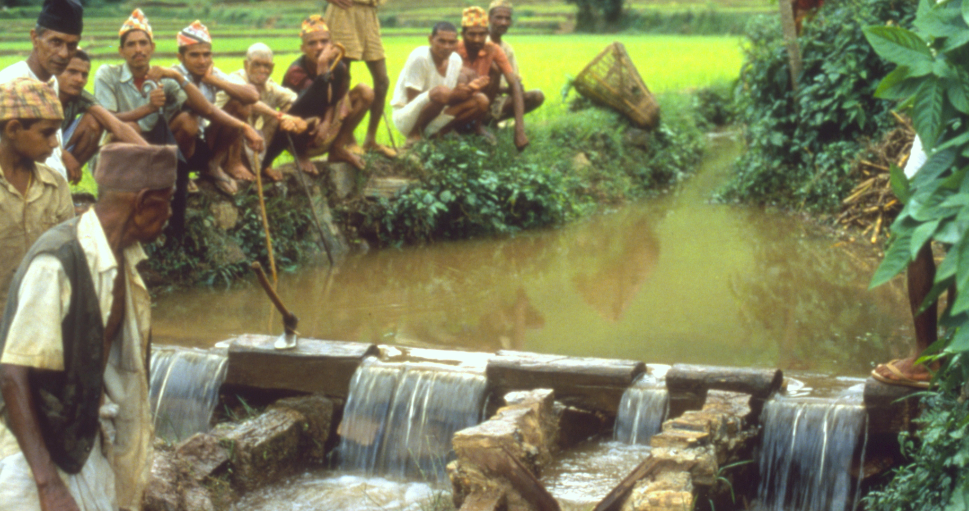
SOCIOTECHNICAL | GOVERNANCE | COORDINATION | FRAMEWORK | CASE STUDY 1 | CASE STUDY 2 | ACTIVITY | REFLECTION
Commons Governance Styles
Example: Irrigation Systems
Ostrom, Elinor (1990) Governing the Commons

Slide 10
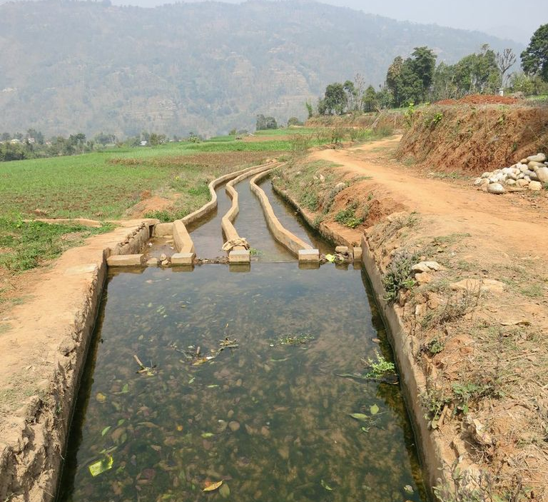
SOCIOTECHNICAL | GOVERNANCE | COORDINATION | FRAMEWORK | CASE STUDY 1 | CASE STUDY 2 | ACTIVITY | REFLECTION
Commons Governance Styles
NOBEL PRIZE
🧑‍🧑‍🧒‍🧒 Community-managed
🏛️ State-managed
Ostrom, Elinor (1990) Governing the Commons

Slide 11
Ostrom’s 8 Gov. Principles
SOCIOTECHNICAL | GOVERNANCE | COORDINATION | FRAMEWORK | CASE STUDY 1 | CASE STUDY 2 | ACTIVITY | REFLECTION
GOVERNANCE PRINCIPLE | EXAMPLE FROM NEPALESE IRRIGATION SYSTEMS
1. Clearly defined boundaries | Farmers knew exactly which fields and canals they had rights to water from.
2. Rules tailored to local conditions | Water-sharing schedules matched seasonal crop needs and terrain differences.
3. Collective choice arrangements | Farmers met to create and update rules democratically.
4. Monitoring | Farmers took turns overseeing water flow and usage compliance.
5. Graduated sanctions | Small infractions (like early water use) led to small fines or social warnings.
6. Conflict resolution mechanisms | Disputes were resolved locally through group meetings or elder mediation.
7. Recognition of right to self-organize | The state allowed farmer groups to operate autonomously.
8. Nested enterprises | Local water groups coordinated with regional irrigation councils.
Ostrom, E., Governing the Commons (1990)

Slide 12
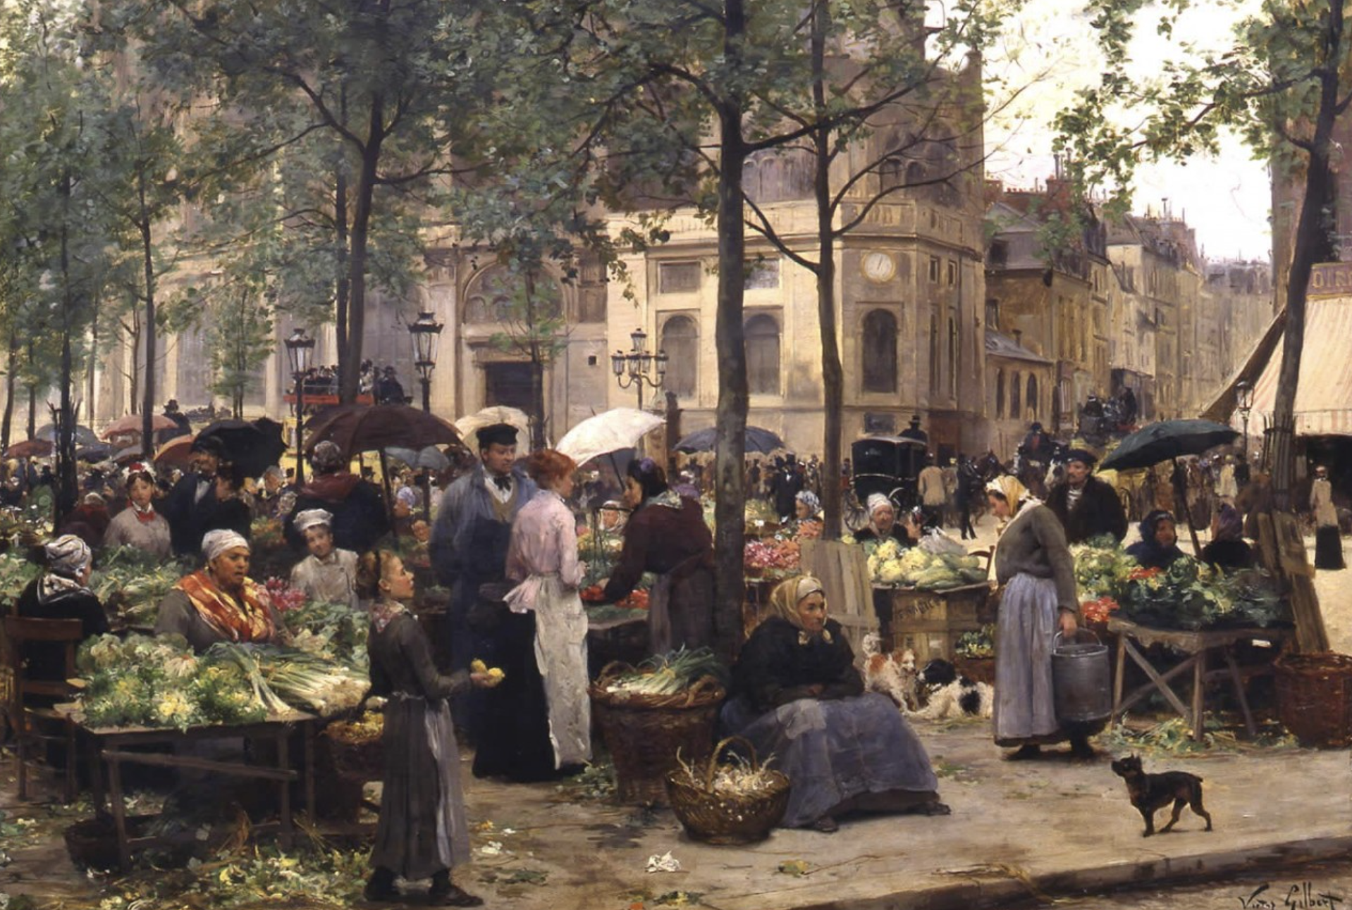
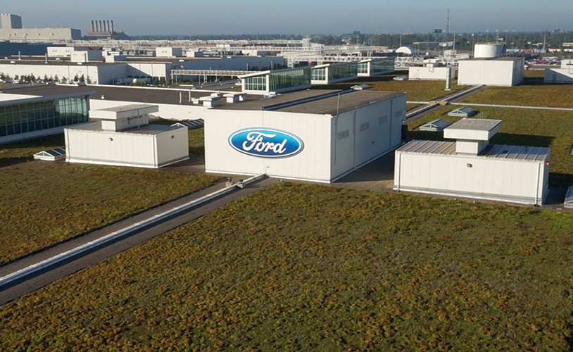
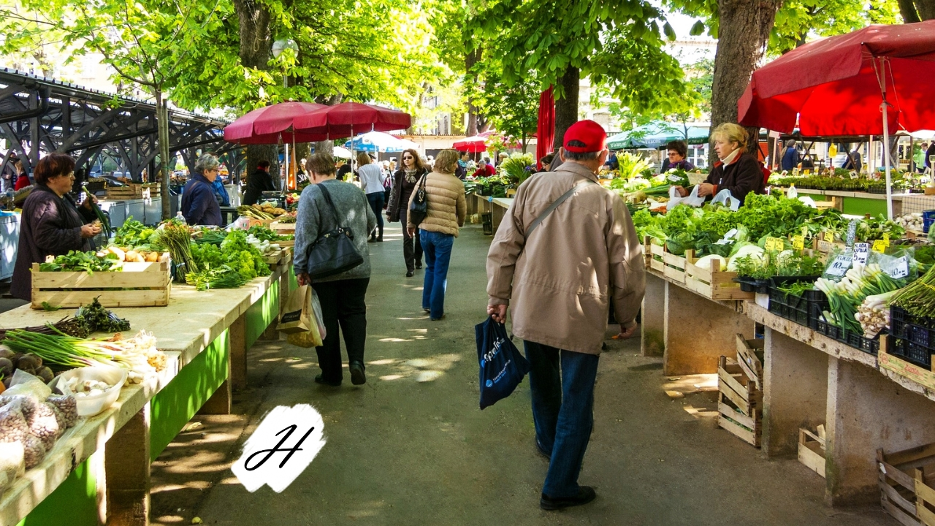
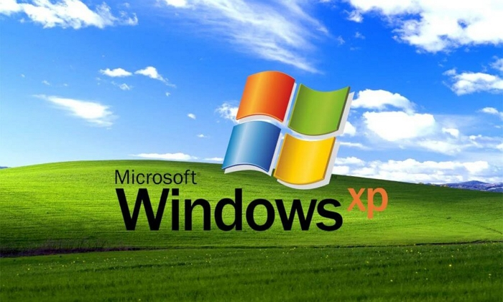

Coordination Styles
SOCIOTECHNICAL | GOVERNANCE | COORDINATION | FRAMEWORK | CASE STUDY 1 | CASE STUDY 2 | ACTIVITY | REFLECTION
(modes of production)
Market-based Production
Firm-based Production
Commons-based Peer Production
Benkler, Yochai (2000) The Wealth of Networks

Slide 13
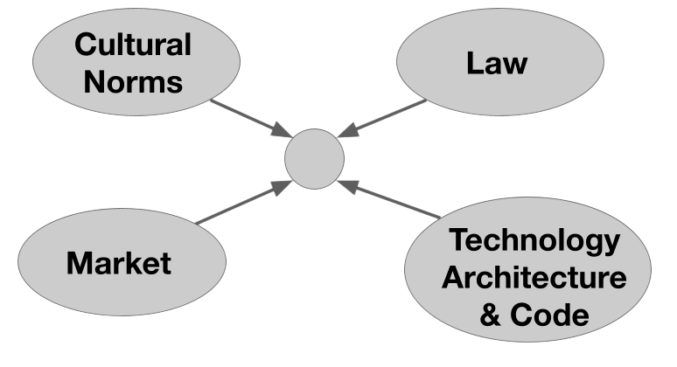

Coordination Styles
SOCIOTECHNICAL | GOVERNANCE | COORDINATION | FRAMEWORK | CASE STUDY 1 | CASE STUDY 2 | ACTIVITY | REFLECTION
(modes of production)
Market-based Production
Firm-based Production
Digital Commons Regulation
Lessig, L. (1999) Code and Other Laws of Cyberspace

Slide 14
Coordination Styles
SOCIOTECHNICAL | GOVERNANCE | COORDINATION | FRAMEWORK | CASE STUDY 1 | CASE STUDY 2 | ACTIVITY | REFLECTION
(modes of production)
Market-based Production
Firm-based Production
Commons-based Peer Production
Benkler, Yochai (2000) The Wealth of Networks

Slide 15
Coordination Styles
SOCIOTECHNICAL | GOVERNANCE | COORDINATION | FRAMEWORK | CASE STUDY 1 | CASE STUDY 2 | ACTIVITY | REFLECTION
(modes of production)
Market-based Production
Firm-based Production
Commons-based Peer Production
Sharing economy
Platform-based Marketplaces

Slide 16
Sociotechnical Frameworks
SOCIOTECHNICAL | GOVERNANCE | COORDINATION | FRAMEWORK | CASE STUDY 1 | CASE STUDY 2 | ACTIVITY | REFLECTION
ASPECT/FRAMEWORK | ANALOG (OSTROM ‘80s) 🏞️ | DIGITAL (BENKLER ‘00s) 🌐
COMMONS TYPE | Natural resources 💧(rivalrous) | Information & culture 💡(non-rivalrous)
GOVERNANCE | Local/social norms 👥 | Polycentric ⚖️
MOTIVATION | Shared need, trust 🤝 | Intrinsic 🌟
COORDINATION | Community meetings 🛖 | Peer contributions 🧑‍💻
FAILURE RISK | Overuse or neglect ⚠️ | Under-participation 🚫
IDEAL OUTCOME | Resilient communities | Free/open knowledge 📚

Slide 17
Sociotechnical Frameworks
SOCIOTECHNICAL | GOVERNANCE | COORDINATION | FRAMEWORK | CASE STUDY 1 | CASE STUDY 2 | ACTIVITY | REFLECTION
ASPECT/FRAMEWORK | ANALOG (OSTROM ‘80s) 🏞️ | DIGITAL (BENKLER ‘00s) 🌐 | PROTOCOLS (‘20s) 🔗
COMMONS TYPE | Natural resources 💧(rivalrous) | Information & culture 💡(non-rivalrous) | Programmable Infrastructure 🛠️ (rivalrous!?)
GOVERNANCE | Local/social norms 👥 | Polycentric ⚖️ | Formalized, code, hardened 🗳️
MOTIVATION | Shared need, trust 🤝 | Intrinsic 🌟 | Ideology + financial 🪙
COORDINATION | Community meetings 🛖 | Peer contributions 🧑‍💻 | Smart contracts, incentives 🤖
FAILURE RISK | Overuse or neglect ⚠️ | Under-participation 🚫 | Centralization, plutocracy 🏦
IDEAL OUTCOME | Resilient communities | Free/open knowledge 📚 | Individual sovereignty, infra for economic & social life 🧵

Slide 18



Case study: decentralized social media protocols
SOCIOTECHNICAL | GOVERNANCE | COORDINATION | FRAMEWORK | CASE STUDY 1 | CASE STUDY 2 | ACTIVITY | REFLECTION
AT Proto
ActivityPub
Oshinowo, Hwang, Zhang, Monroy-Hernández (2025) Seeing the Politics of Decentralized Social Media Protocols

Slide 19
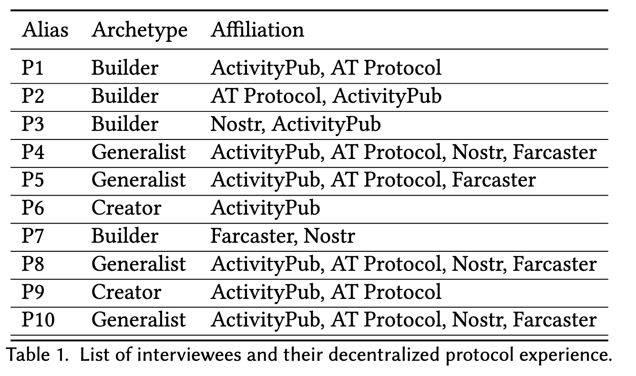
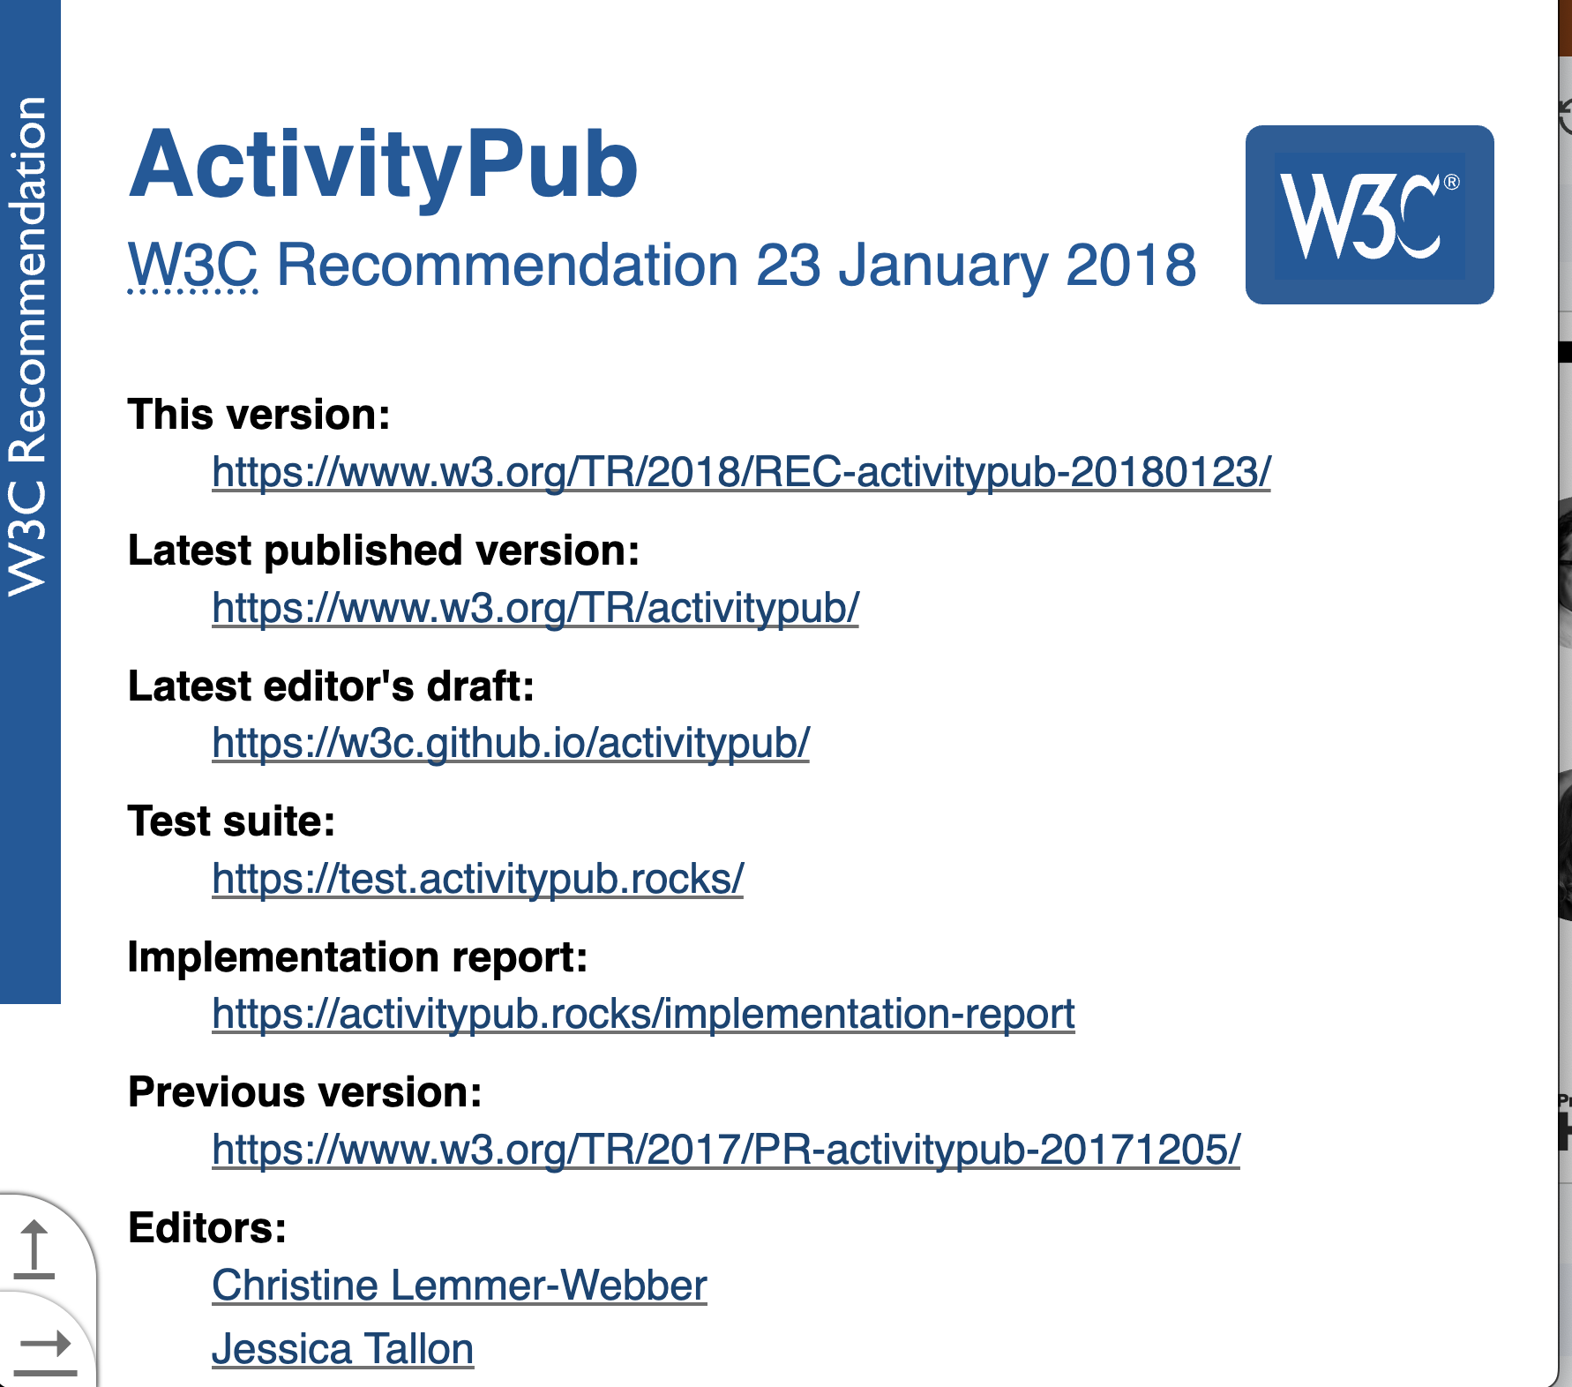
Case study: decentralized social media protocols
SOCIOTECHNICAL | GOVERNANCE | COORDINATION | FRAMEWORK | CASE STUDY 1 | CASE STUDY 2 | ACTIVITY | REFLECTION
Oshinowo, Hwang, Zhang, Monroy-Hernández (2025) Seeing the Politics of Decentralized Social Media Protocols

Slide 20
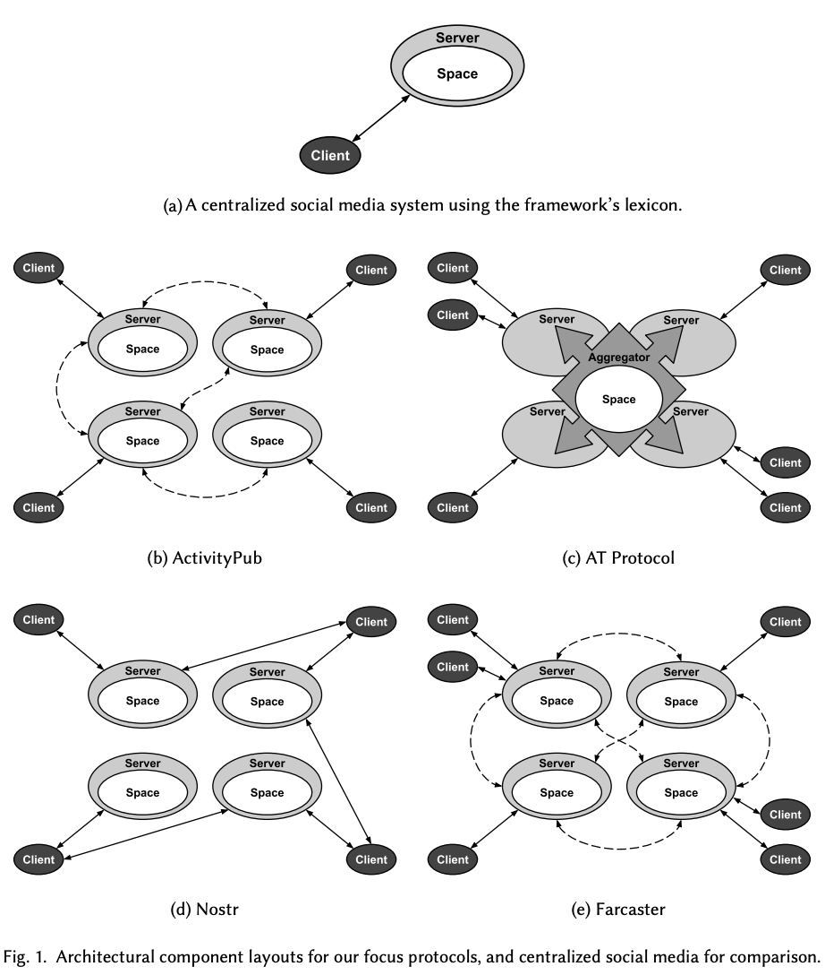
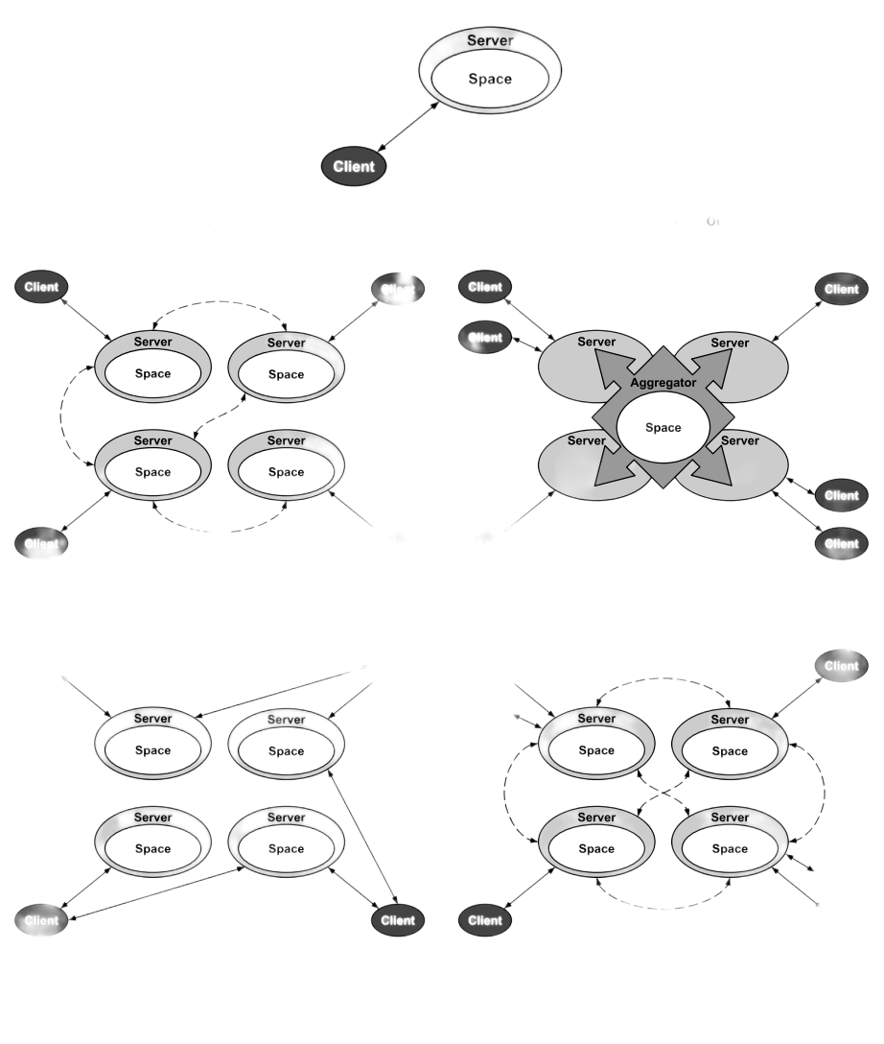
Protocol Architecture
SOCIOTECHNICAL | GOVERNANCE | COORDINATION | FRAMEWORK | CASE STUDY 1 | CASE STUDY 2 | ACTIVITY | REFLECTION
Traditional Centralized Platform
Oshinowo, Hwang, Zhang, Monroy-Hernández (2025) Seeing the Politics of Decentralized Social Media Protocols

Slide 21


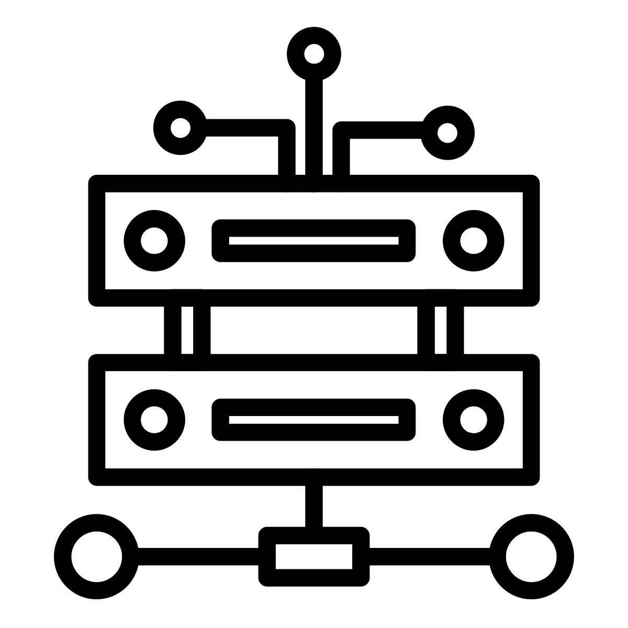
Protocol Architecture Power
SOCIOTECHNICAL | GOVERNANCE | COORDINATION | FRAMEWORK | CASE STUDY 1 | CASE STUDY 2 | ACTIVITY | REFLECTION
(tensions)
Power over identity
Power over curation
Power over infrastructure
Server-managed identity → easier for users, but less autonomy (e.g. ActivityPub) – power to communities
User: User-held keys → more agency, but riskier (e.g. Nostr, Farcaster) – power to individuals
Client-only-determined → more streamlined, but less flexible (e.g. AT Protocol, Nostr) – power to individuals
Client and Server-determined → more flexible, but more inter-community friction (e.g. ActivityPub) – power to communities
Low barrier to become an infra owner → accessible, but confusing to users (e.g. ActivityPub) - power to communities
High barrier to become an infra owner → more end-user friendly, but centralized (e.g. AT Protocol) – power to platforms
Oshinowo, Hwang, Zhang, Monroy-Hernández (2025) Seeing the Politics of Decentralized Social Media Protocols

Slide 22
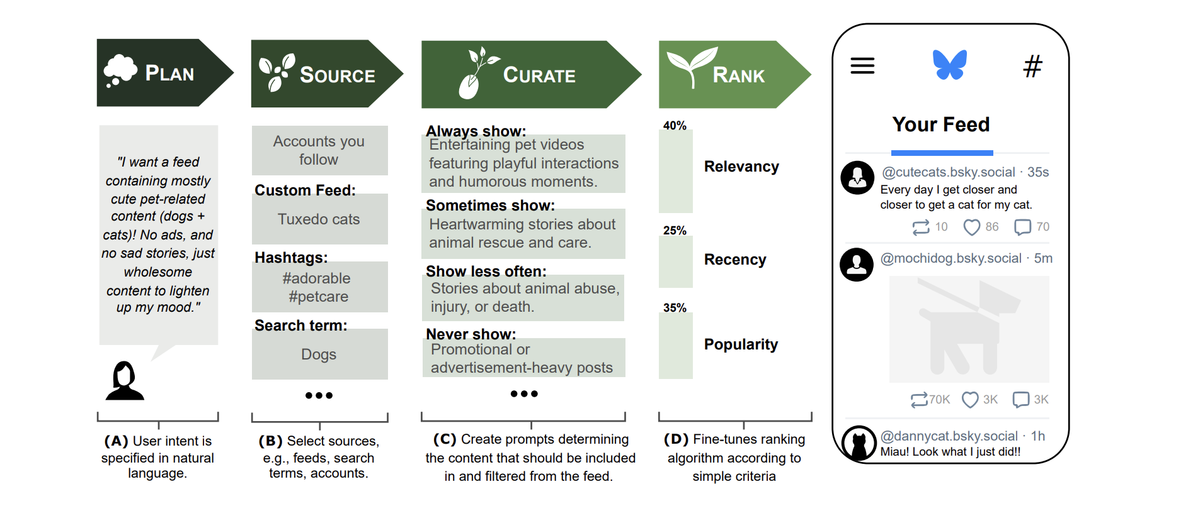
LLMs to leverage individual curation power
SOCIOTECHNICAL | GOVERNANCE | COORDINATION | FRAMEWORK | CASE STUDY 1 | CASE STUDY 2 | ACTIVITY | REFLECTION
O. El Malki, M. Aubin Le Quéré, A. Monroy-Hernández, M. Horta Ribeiro. (2025) BONSAI: Intentional and Personalized Social Media

Slide 23

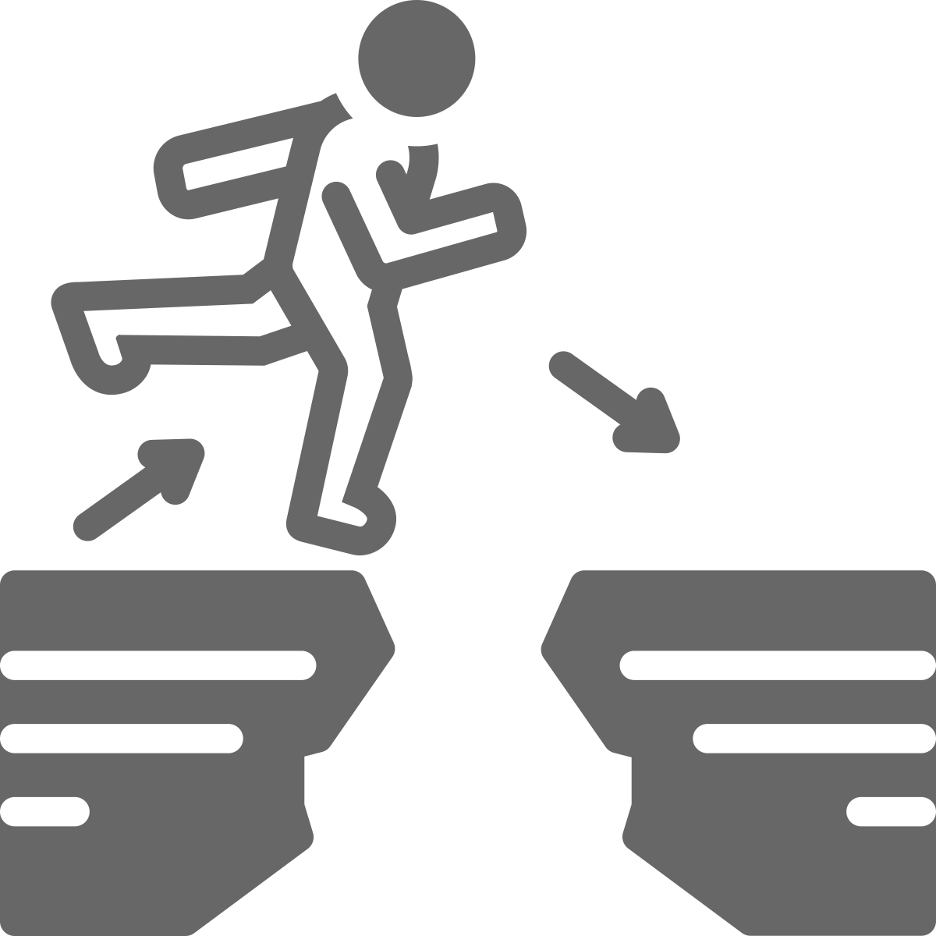
Social-technical gap
Artifacts have politics
SOCIOTECHNICAL | GOVERNANCE | COORDINATION | FRAMEWORK | CASE STUDY | CONCLUSION
Artifacts have politics because they embody and enforce particular social relations.
Technologies aren’t neutral — they shape who can do what, who holds power, and whose values are encoded.
The design of roads, software protocols, network architectures → all can structure political outcomes
Langdon Winner (1980) Do artifacts have politics?
social science
eng.
“The social-technical gap is the divide between what we know we must support socially and what we can support technically.”
Ackerman (2000)

Slide 24


Imagining new protocols for communities
SOCIOTECHNICAL | GOVERNANCE | COORDINATION | FRAMEWORK | CASE STUDY 1 | CASE STUDY 2 | ACTIVITY | REFLECTION
Problem: governance frictions*
* Hwang, Nanayakkara, Shvartzshnaider (2025) Trust and friction: negotiating how information flows through decentralized social media

Slide 25
Imagining new protocols for communities
SOCIOTECHNICAL | GOVERNANCE | COORDINATION | FRAMEWORK | CASE STUDY 1 | CASE STUDY 2 | ACTIVITY | REFLECTION
Problem: governance frictions*
Example. Privacy violations.
Security practices
Software affordances
Values & rules
* Hwang, Nanayakkara, Shvartzshnaider (2025) Trust and friction: negotiating how information flows through decentralized social media

Slide 26
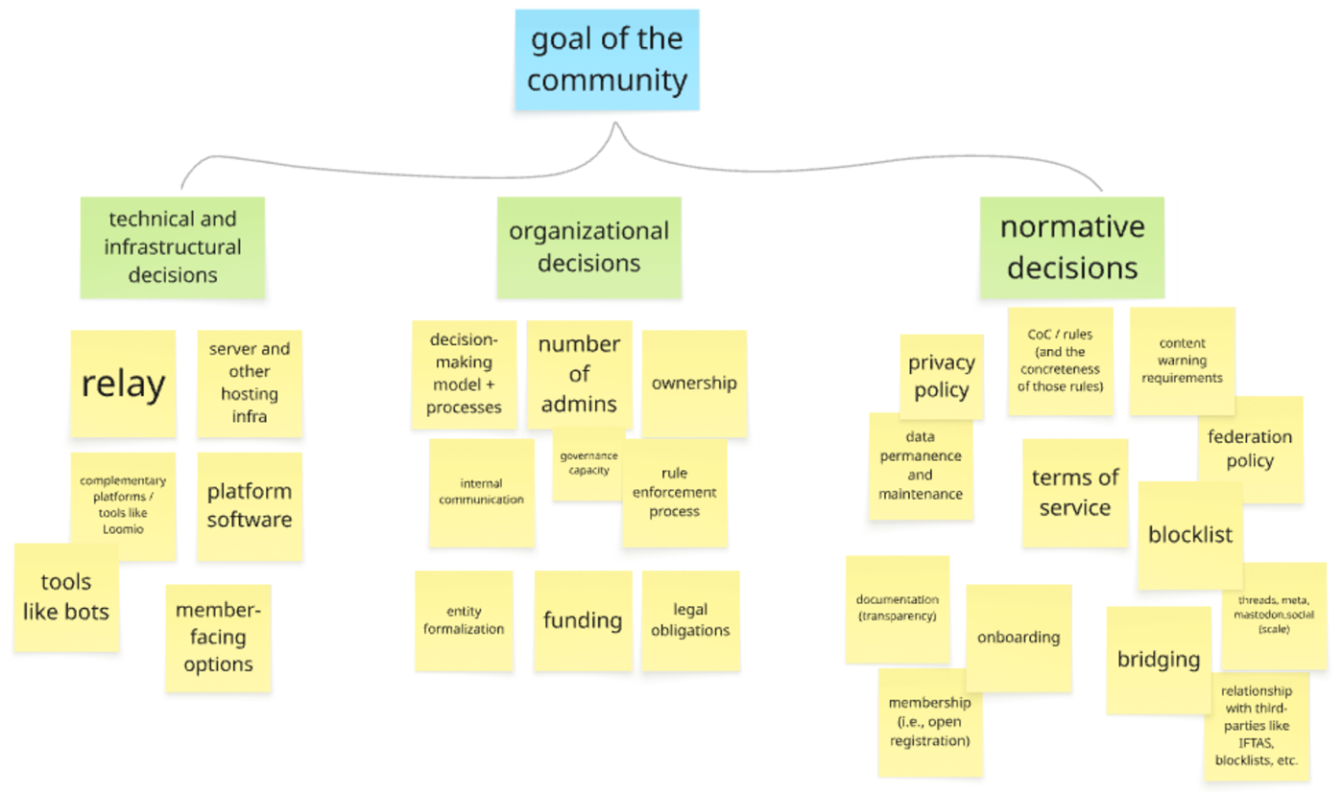
Design workshops
SOCIOTECHNICAL | GOVERNANCE | COORDINATION | FRAMEWORK | CASE STUDY 1 | CASE STUDY 2 | ACTIVITY | REFLECTION
2-3 hour sessions
4 sessions, with overall 24 people
Imagining ideal workflows to address governance frictions around community decisions

Slide 27
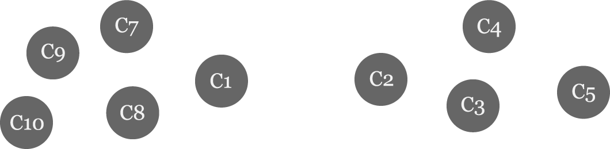
SOCIOTECHNICAL | GOVERNANCE | COORDINATION | FRAMEWORK | CASE STUDY 1 | CASE STUDY 2 | ACTIVITY | REFLECTION

Slide 28
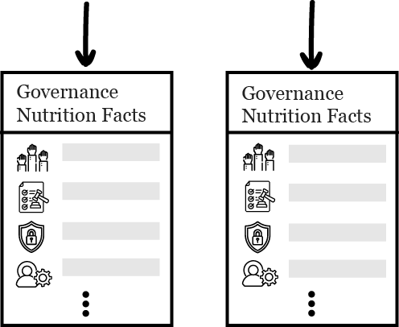
SOCIOTECHNICAL | GOVERNANCE | COORDINATION | FRAMEWORK | CASE STUDY 1 | CASE STUDY 2 | ACTIVITY | REFLECTION

Slide 29
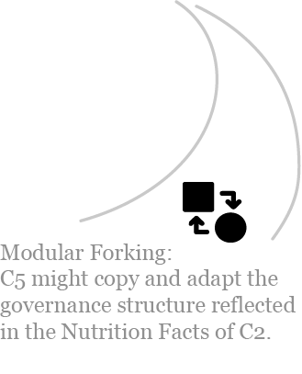
SOCIOTECHNICAL | GOVERNANCE | COORDINATION | FRAMEWORK | CASE STUDY 1 | CASE STUDY 2 | ACTIVITY | REFLECTION

Slide 30
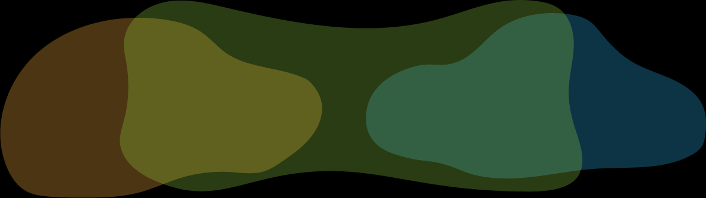
SOCIOTECHNICAL | GOVERNANCE | COORDINATION | FRAMEWORK | CASE STUDY 1 | CASE STUDY 2 | ACTIVITY | REFLECTION

Slide 31
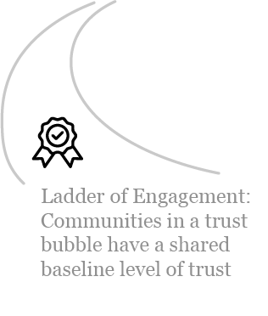

Slide 32
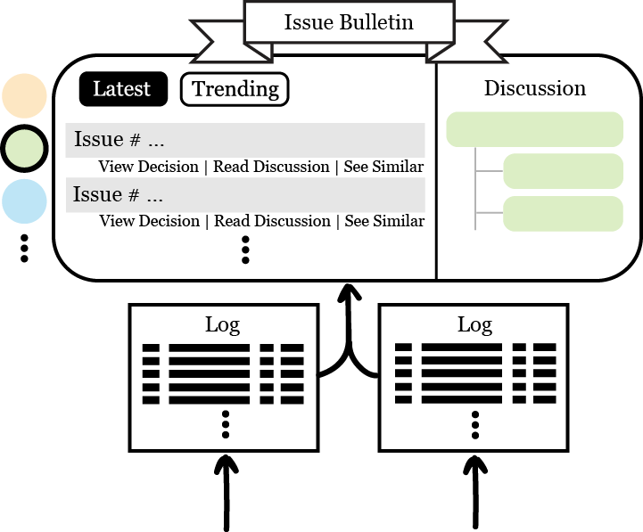
SOCIOTECHNICAL | GOVERNANCE | COORDINATION | FRAMEWORK | CASE STUDY 1 | CASE STUDY 2 | ACTIVITY | REFLECTION

Slide 33
SOCIOTECHNICAL | GOVERNANCE | COORDINATION | FRAMEWORK | CASE STUDY 1 | CASE STUDY 2 | ACTIVITY | REFLECTION

Slide 34
Designing for intercommunity governance
SOCIOTECHNICAL | GOVERNANCE | COORDINATION | FRAMEWORK | CASE STUDY 1 | CASE STUDY 2 | ACTIVITY | REFLECTION

Slide 35
Designing for intercommunity governance
SOCIOTECHNICAL | GOVERNANCE | COORDINATION | FRAMEWORK | CASE STUDY 1 | CASE STUDY 2 | ACTIVITY | REFLECTION
Modular
Forkable
Polycentric

Slide 36
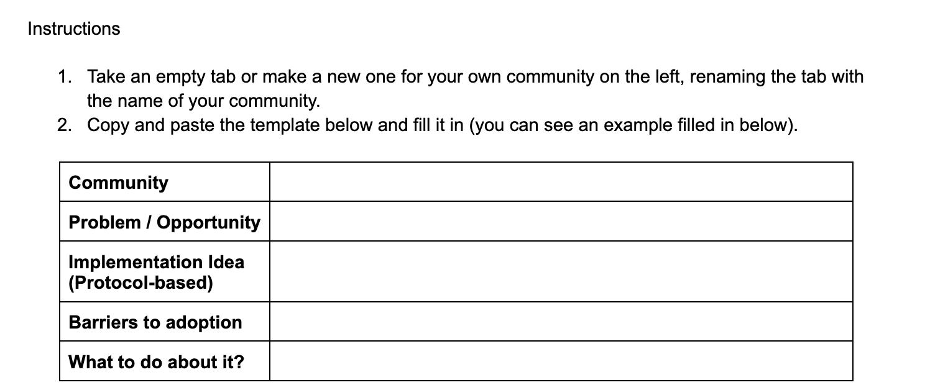
Exercise:
Protocols that do not exist that could help the community you thought of earlier
SOCIOTECHNICAL | GOVERNANCE | COORDINATION | FRAMEWORK | CASE STUDY 1 | CASE STUDY 2 | ACTIVITY | REFLECTION

Slide 37
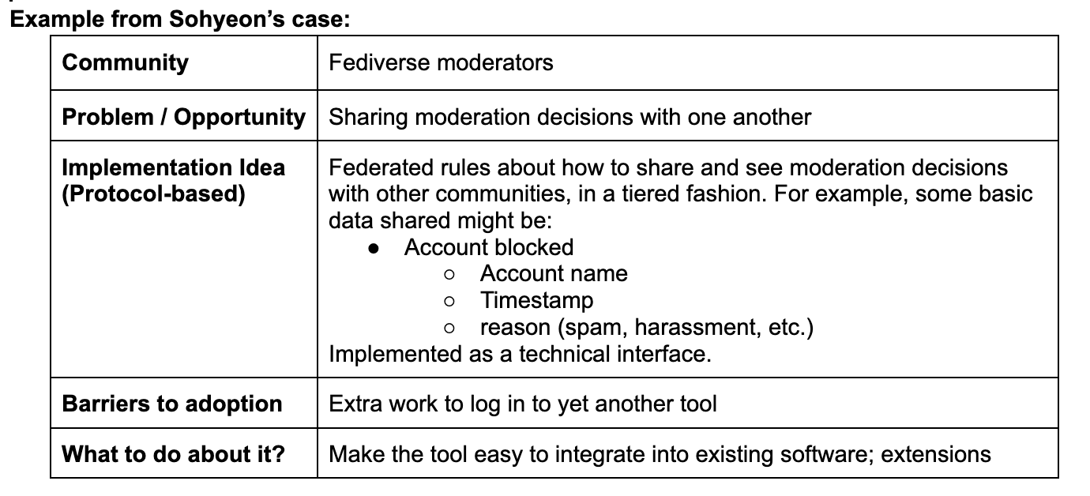
Exercise (10 min):
Protocols that do not exist that could help the community you thought of earlier
Go to → https://www.yellkey.com/hand

Slide 38
Breakout (7 min):
Share your protocol.
Problem it responds to.
Should it be social, technical, or sociotechnical? Why?
What makes it hard to institutionalize?
Choose 1 person to be a note taker who will share 1 takeaway with the full group after

Slide 39
Full Group Discussion:
Note taker: share 1 thing that emerged from the discussion

Slide 40
Thanks!

